Slide 1
Aggressive Prefetching for Graph Application
Patel MIT
2020CSM1016
IIT Ropar
Under the guidance of Dr. T.V. Kalyan
PG Seminar 2

Slide 2
INTRODUCTION
Prefetching is a Method to Predict the data needed in future and fetch them into cache before it is requested by Program
Benefits?
Reduce the Compulsory misses
Reduce memory Latency

Slide 3
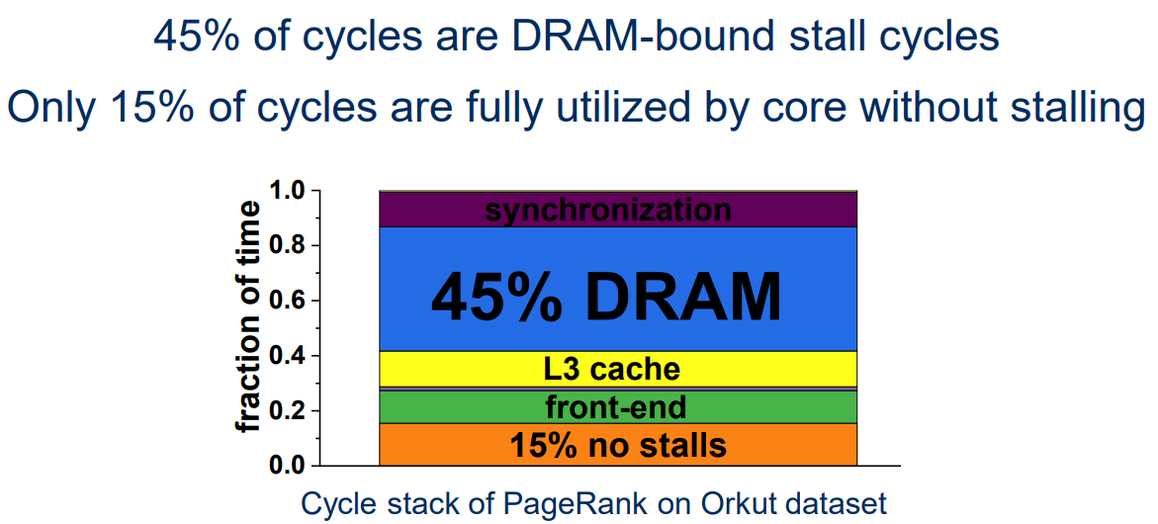
Memory Is Bottleneck
Cite From “Analysis and Optimization of the Memory Hierarchy for Graph Processing Workloads”

Slide 4
Existing LLCC Prefetcher
VLDP(Variable Length Data Prefetcher)
Builds up delta histories between successive cache line misses within physical pages and then use these Offset histories to predict the order of the cache line misses in new pages
SMS (Spatial Memory Streaming)
SMS captures page-level access patterns by storing spatial patterns by storing bit vectors and use this vector bit to Prefetch block.
BOP (best Offset Prefetcher)
Dynamically set one best Offset for Prefetcher using Recent Accesses.

Slide 5
Trace generation (GAP)
Graph Kernel (Program)
Page-Rank (PR) | Rank each vertex on the basis of the ranks of its neighbors
Breadth First Search (BFS) | Traverse a graph level by level
(TC) | Triangle Counting Algorithm
DATASET | VERTICES | EDGES
AMAZON | 410236 | 2439437
ROAD CA | 1971281 | 2766607

Slide 6
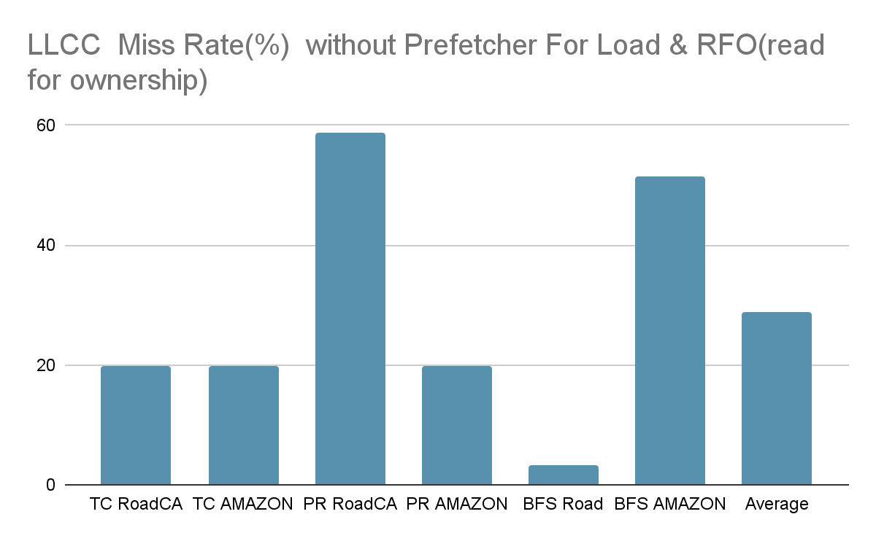
Observation 1 – high miss rate 28.84

Slide 7
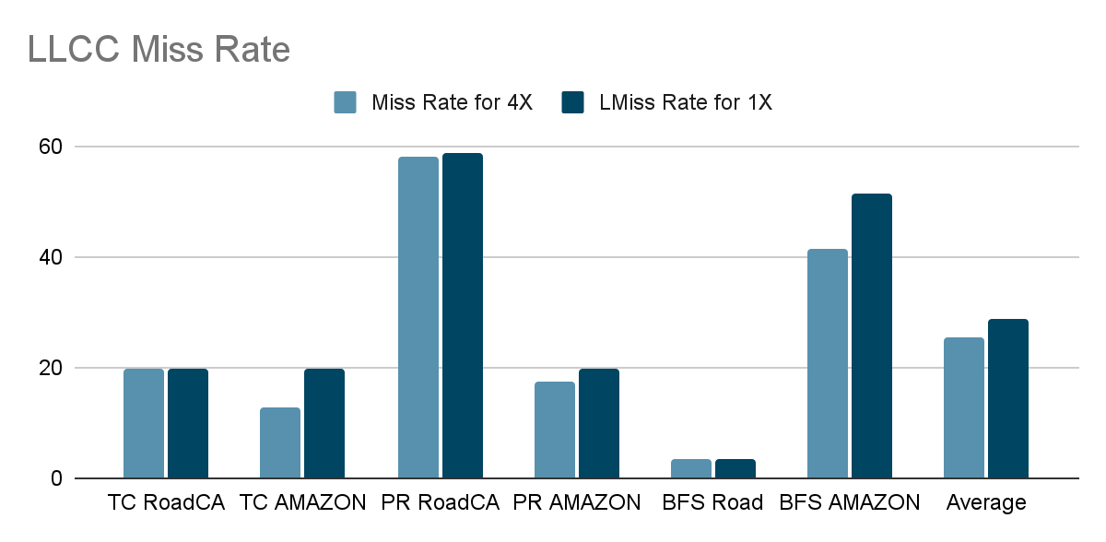
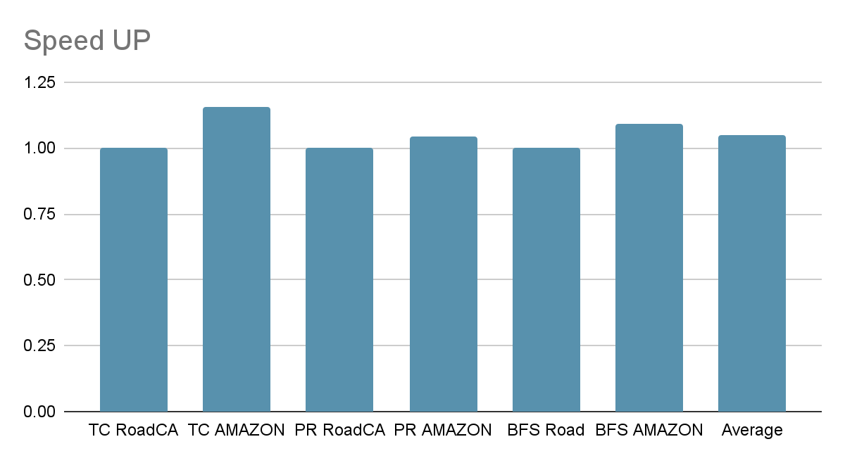
Observation 2 – 5% improvement for 4X LLC

Slide 8
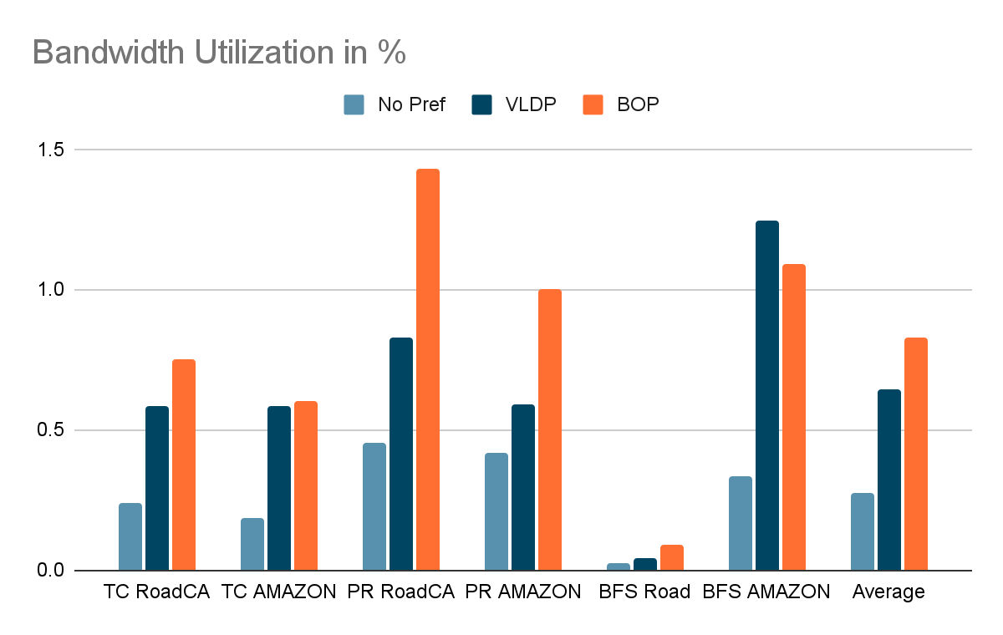
Observation 3 – BW utilization is less

Slide 9
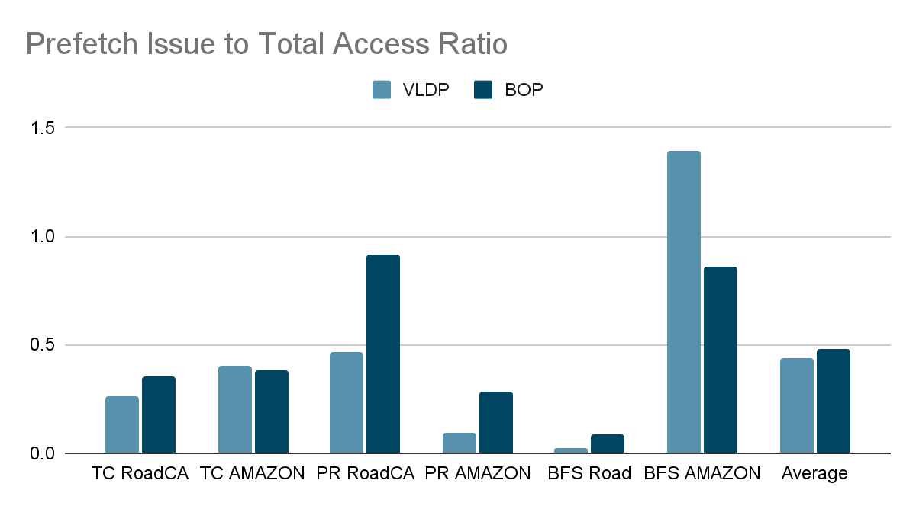
Observation 4 – very less Pref Req 0.5

Slide 10
Conclusion from Observation
LLCC has very high Miss Rate That Means there is not Much Locality in Memory Reference
Take risk to prefetch
Do not care Much About pollution
BandWidth Utilization is very Less
Even if we prefetch more Address it will be no issue because we already have low memory bandwidth utilization
Since Graph BenchMarks are Hard to Predict Accurately
Try to Prefetch More so increased Coverage more instead Accuracy
Key Ides is “Prefetch Aggressively”

Slide 11
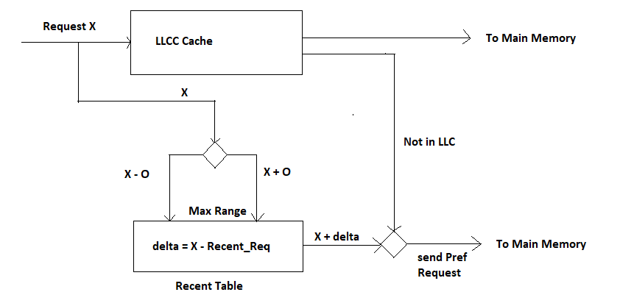
IMPLEMENTATION

Slide 12
IMPLEMENTATION
Eg. Recent Table = [ 15 , 54, 75 , 96, 940, 1005 ] and MaxOffset ( O )=25
Request ( X ) is 66 then
Prefetch Range is [ 66 - 25 , 66 + 25] == [ 44 , 91]
So concerned Request is { 54 , 75 }
For 54 send Prefetch Request for 66 + (66-54) == 78 /* sequence 54 – 66 – 78 */
For 75 send Prefetch Request for 66 + (66-75) == 57 /* sequence 75 – 66 — 57 */

Slide 13
Array Accessing
Array A , base address =100 , size 1000
Forward : Accessed data 100 , 102 …. 1099
Total Predicted Address 103 , 104 , ….. 1099 +25
Useful = 998 , Useless =25
Backward Access 1999,198,.......100
Total Predicted Address 1097 ,1096,...76,
Useful = 998 , Useless =25

Slide 14
Matrix Multiplication
A =[10][100] , B =[100][10] , C = [10][10]
Base address A=1000 , B=4000 , C=6000
C = A >< B
Access Pattern A = 1000 , 1001 , 1002 … 1099
Predicted Pattern 1002 , 1003 …. 1099+25 , useful = 998 , Useless=25
Access Pattern B = 4000 , 4010 , 4020 , ……4990
Predicted Pattern 4020,4030 …. 4990+10 , useful = 998 , useless = 1
Issue is if Array[ n ][ m ] where m > 25 then we can not able to predict vertical Access

Slide 15
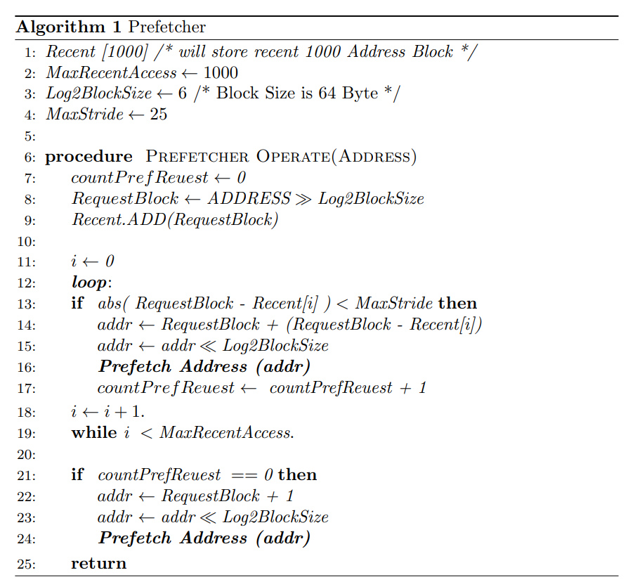
Algorithm of
Aggressive
Prefetcher

Slide 16
Experimental SetUP
Champsim Configuration
Memory Overhead 4kB For Recent Table
CPU Configuration | Num_core 4 , FETCH_WIDTH 4 ,SCHEDULER_SIZE 100
L1-I Configuration | SET 128 , WAY 8, LATENCY 1, PerCore ,64 KB
L1-D Configuration | SET 128 , WAY 8, LATENCY 1, PerCore ,64 KB
LLCC Configuration | SET NUM_CPUS * 2048,WAY 16 , LATENCY 10 , Size 8 MB Replacement Policy = DRRIP,
Main Memory | CHANNELS 1 , RANKS 8 , SIZE = 4GB DRAM_WQ_SIZE 192 , DRAM_RQ_SIZE 192

Slide 17
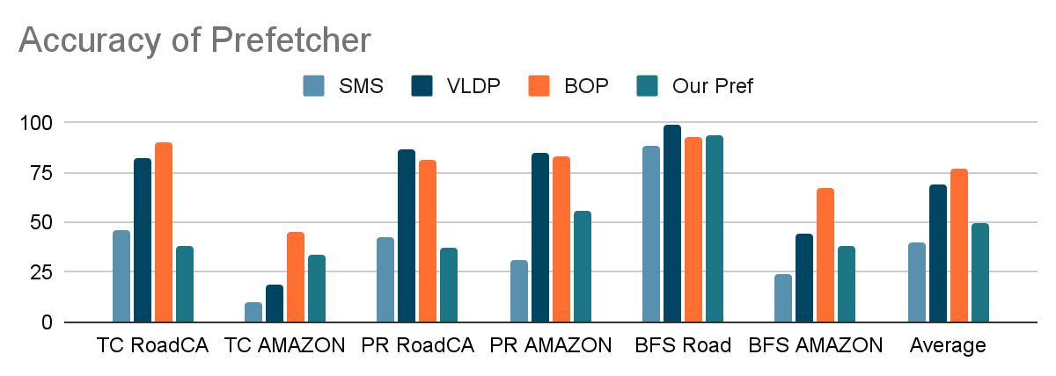
Results 1

Slide 18
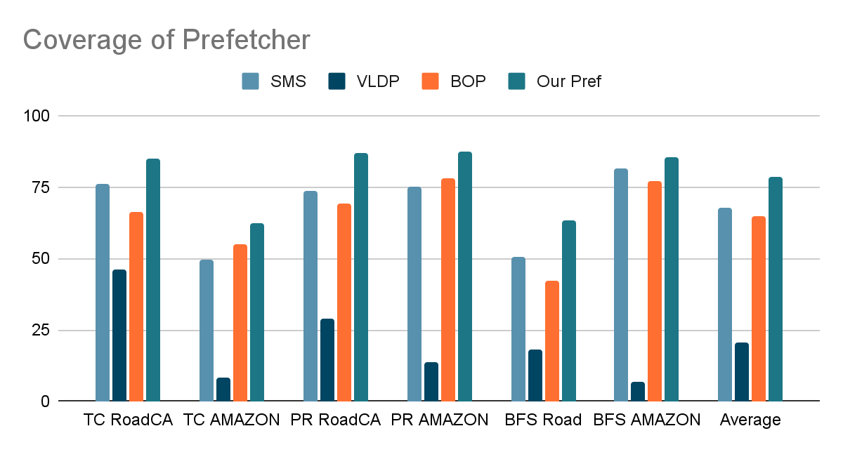
Results 2

Slide 19
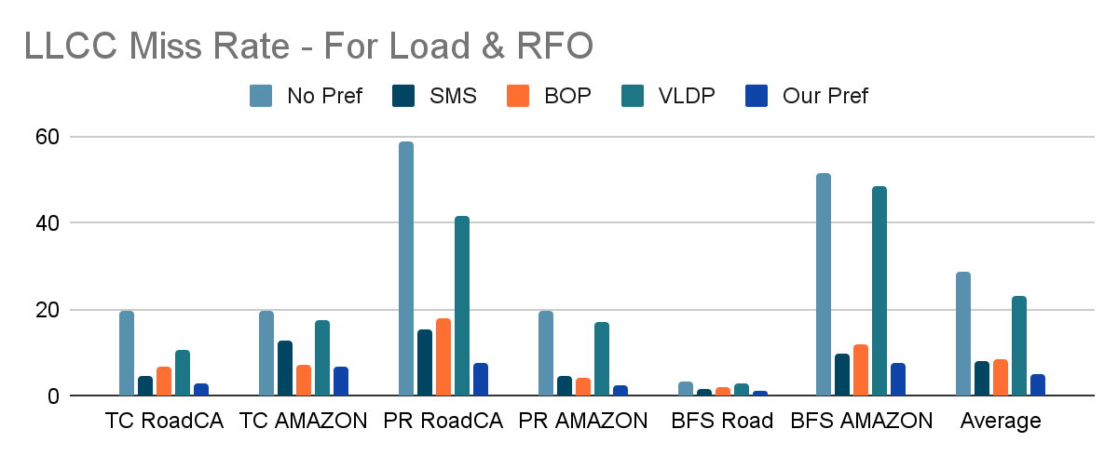
Results 3

Slide 20
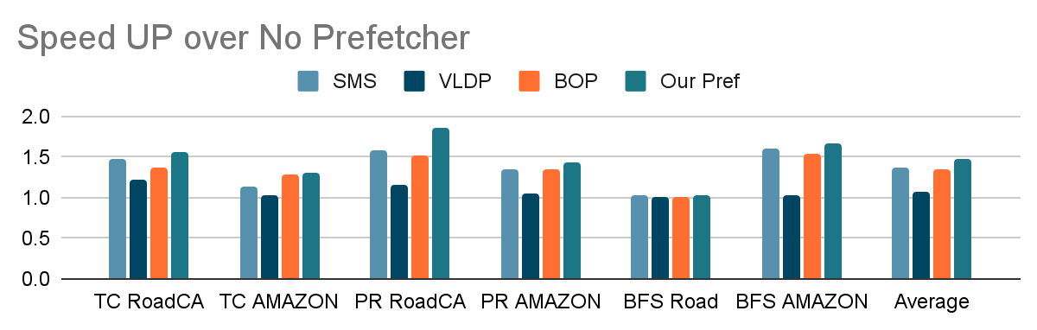
Results 4

Slide 21
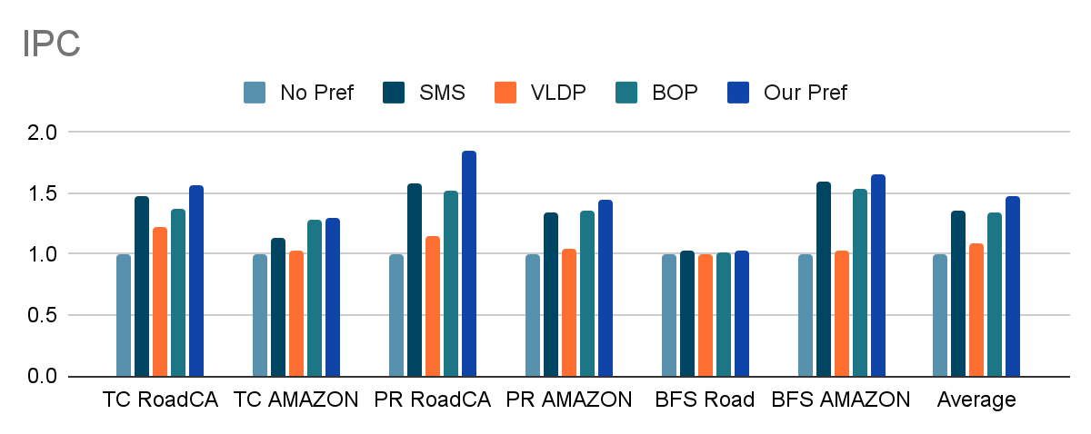
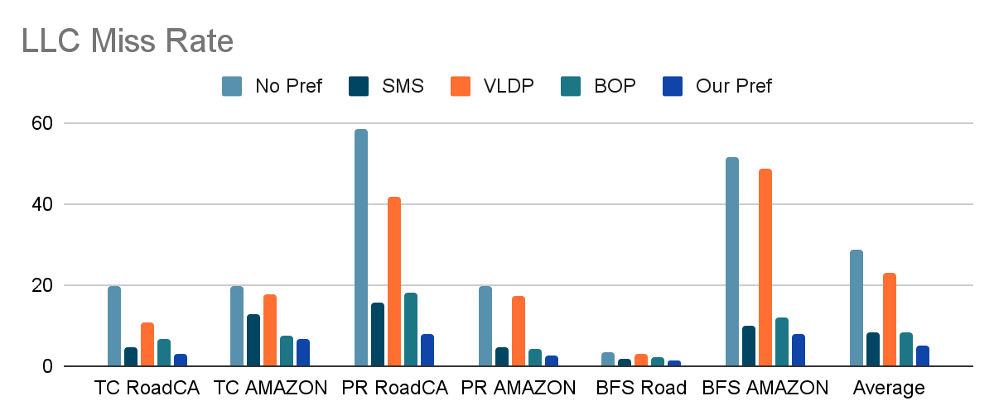

Slide 22
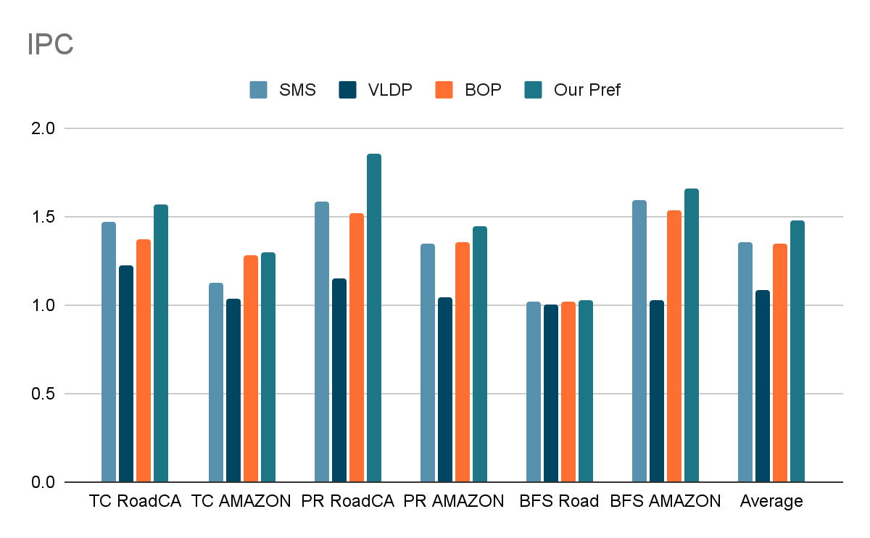
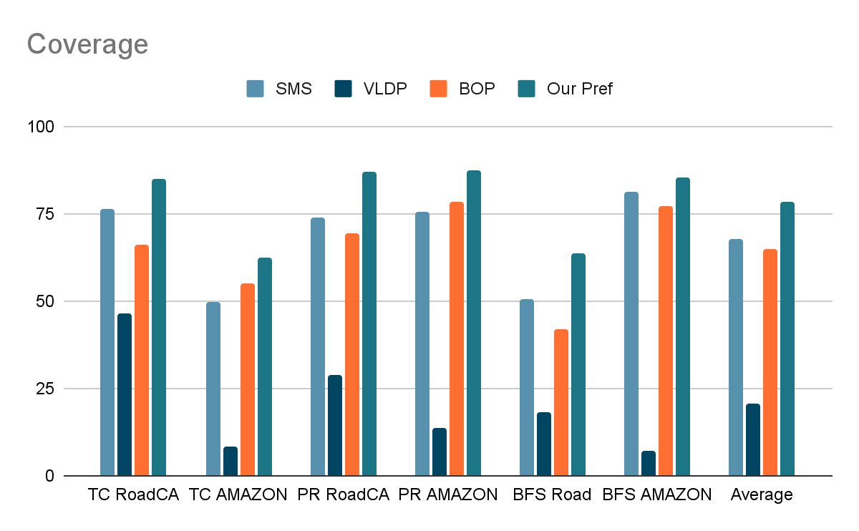

Slide 23
Final Take Away
Aggressive Prefetcher work better with Higher LLC Miss Rate
Performance of Program (IPC) is closely allied to Coverage of Prefetcher For Graph based Benchmarks
High Accuracy with Low Coverage is Not Improving Performance Eg. VLDP (variable Length Data Prefetcher)
Design Prefetcher which is LLC Miss rate Aware

Slide 24
Future Work
Experiments on More Graph Benchmark
Work on Algorithm to improve Accuracy while preserving Coverage With Data Structure aware Prefetcher
Study on pollution and Timeline ness of prefetcher and Bandwidth Utilization of Prefetcher
Compare work with some other Graph Specific Prefetcher like Droplet , Bingo etc..

Slide 25
Thanks

Slide 26
References
Not Quite My Tempo: Matching Prefetches to Memory Access Times Mark
Bouquet of Instruction Pointers: Instruction Pointer Classifier-based Spatial Hardware Prefetching
Best-Offset Hardware Prefetching ,Pierre Michaud
P-OPT: Practical Optimal Cache Replacement for Graph Analytics
Analysis and Optimization of the Memory Hierarchy for Graph Processing Workloads

Slide 27
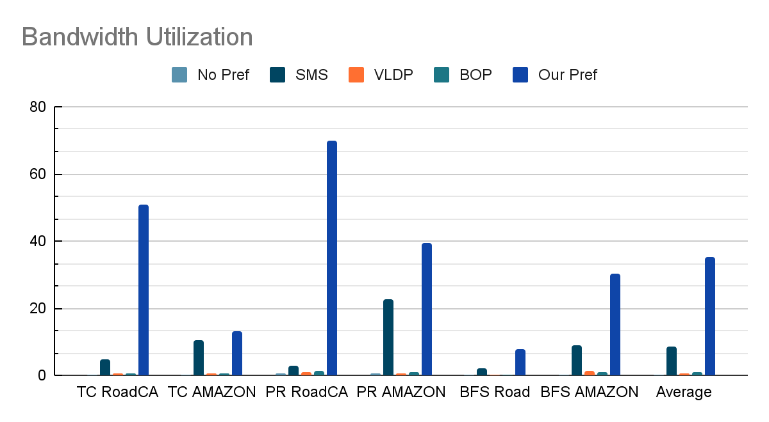
Results 5

